Slide 1
AED Placement Optimization
Interventions Improvement for Cardiac Arrest Cases
in Flemish Brabant & Brussels
Team DPlus
Meixing Liao, Yitong Li, Sifan Shen, Jierong Wen, Xing Wang
2024-02-21
Notes:
Dear committee, good afternoon!
We are Team DPlus. It is our great honor to present our project AED Placement Optimization.
9’89

Slide 2



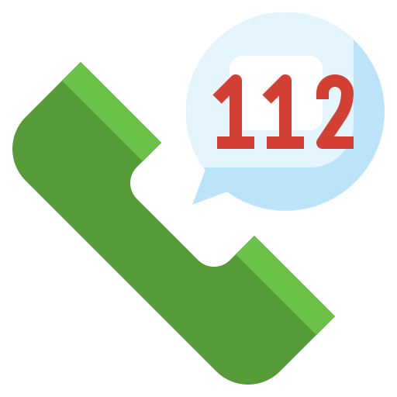
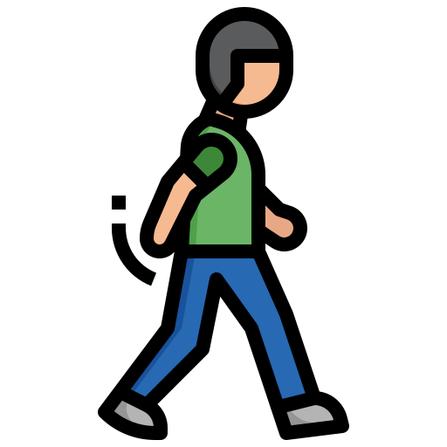

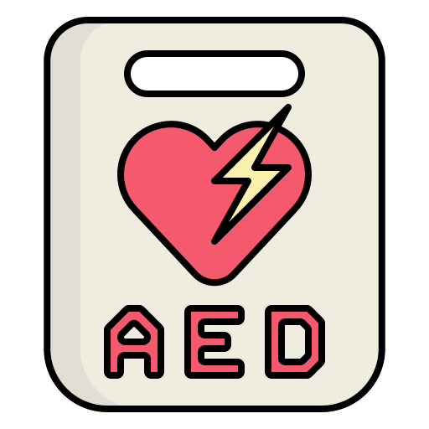

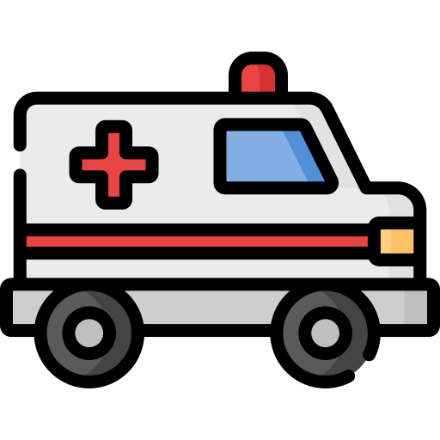

Background
>90%
The chance of survival decreases by 10% each minute without the use of defibrillator.
EVERY MINUTE MATTERS!
50%
%Survival
<10%
0
4
5
12
Minutes to first stock
Notes:
Let me start with my own story.
Back to my high school, I witnessed a death due to sudden heart attack.
I didn’t know anything except calling the ambulance. However, when the ambulance came, it was too late.
To avoid these tragedies, I became a first-aider at 18, from the training I know that every minute matters. The faster applying AED and CPR, the higher possibility to survive and avoid brain damage.

Slide 3
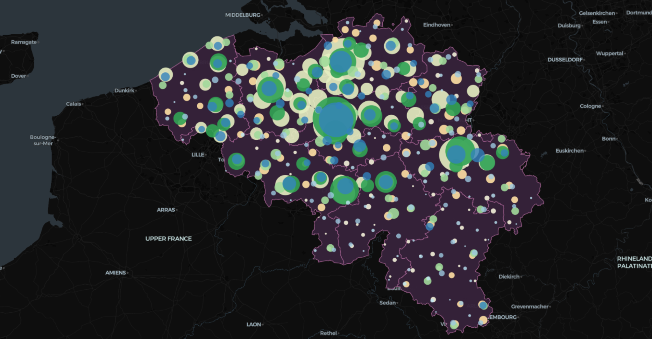
Background and Assumptions
Hospitals
CA Interventions
AEDs
Notes:
Here are the locations of the cardiac attack intervention, hospitals and AEDs in Belgium.
As you can see, the white circles are not fully covered by the other 2 colors, which means people are still helpless in these cases.

Slide 4
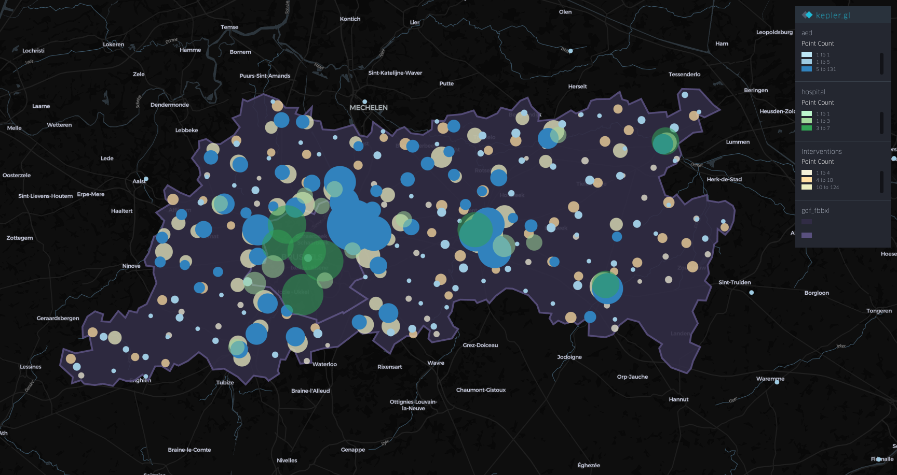
Hospitals
CA Interventions
AEDs
Notes:
Let’s zoom in to our province and the capital region. You can see the hospitals are centralized located while the heart attack can happen anywhere. There is indeed a need of more AEDs placing in optimized locations.

Slide 5



Uncovered Points
Data: P003 (Cardiac Arrest) event type interventions
Covered Points:
≤ 4 minutes driving distance (4000 meters) to/from the nearest hospital
≤ 2 minutes of walking distance (200 meters) to the nearest AED
Only 37% (Cardiac Arrest) event type interventions are covered
in Flemish Brabant and Brussels-Capital Region!
Uncovered Points:
otherwise
4 min
2 min
200 m
Round-trip
( running)
4000 m
One-way
(driving)

Slide 6
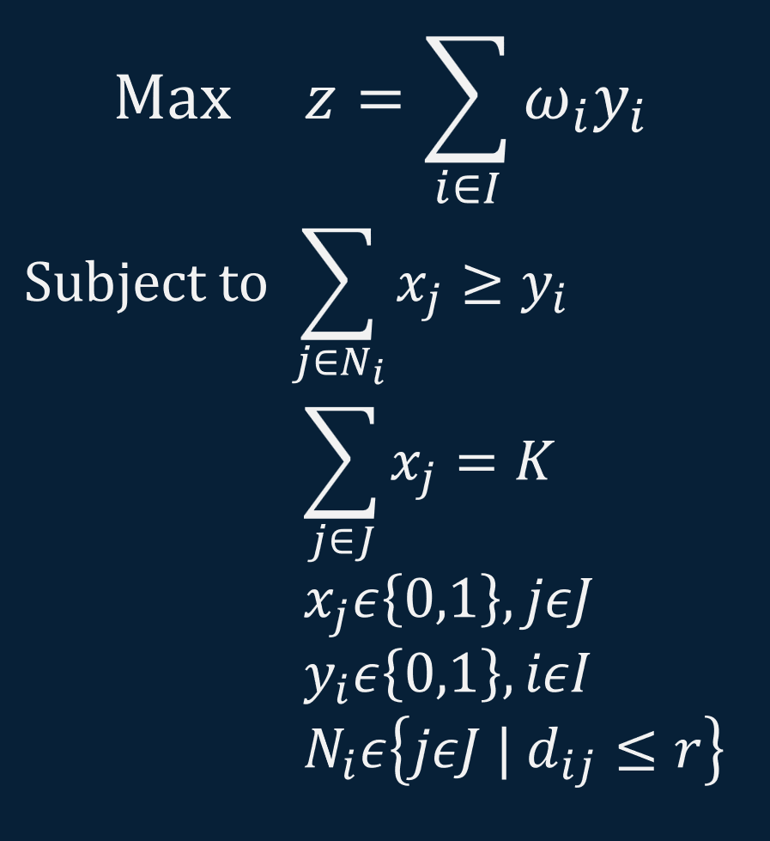
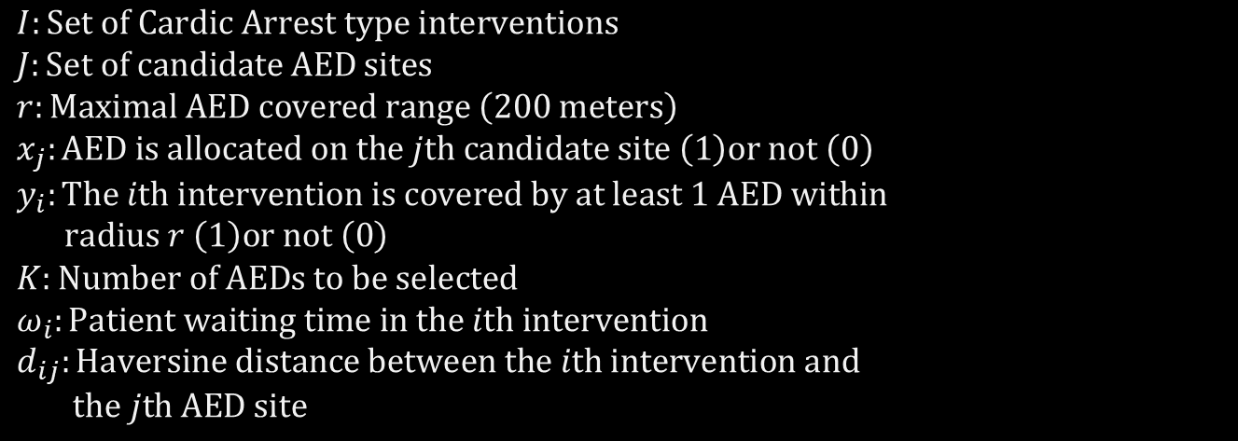
Maximal Coverage Location Optimization Problem for AED Placement

Slide 7
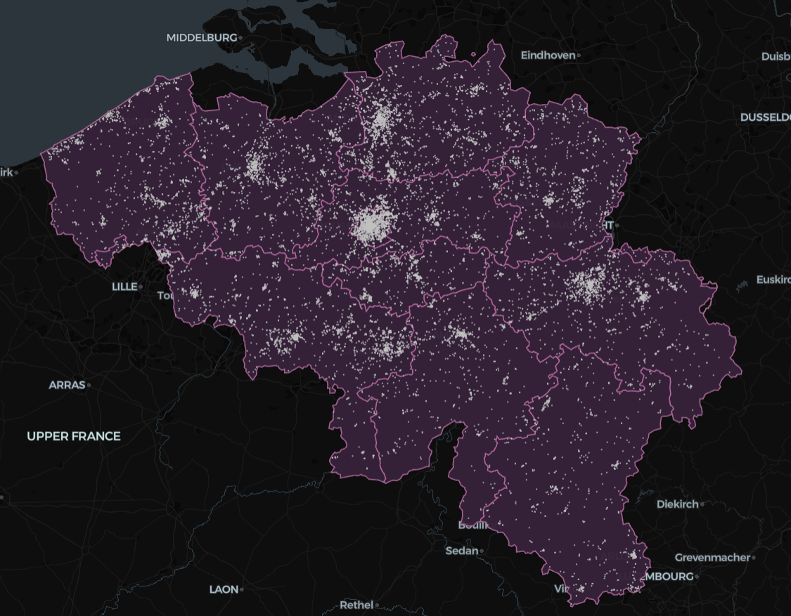
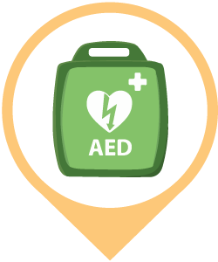

Assumptions
Solution A
Existing AEDs can be relocated
AED optimized locations are feasible
Solution B
Existing AEDs are fix
AED optimized locations are feasible

Slide 8
Solution Design A
Existing AED locations are not fix
AED new locations are feasible
Randomly generate
Candidate AED Locations
Current (demo)
Optimized Allocation of
the Existing AEDs
Optimized (demo)

Slide 9




Solution Design B
Existing AED locations are fix
Additional AED locations are feasible
Randomly Generate Candidate AED Locations for 5% New AEDs
Covered vs
Uncovered Points
(based on distance to AED and Hospitals)
Optimized new AED locations for Uncovered Points
Candidate locations (demo)
Covered and uncovered points (demo)
New AED locations (demo)

Slide 10
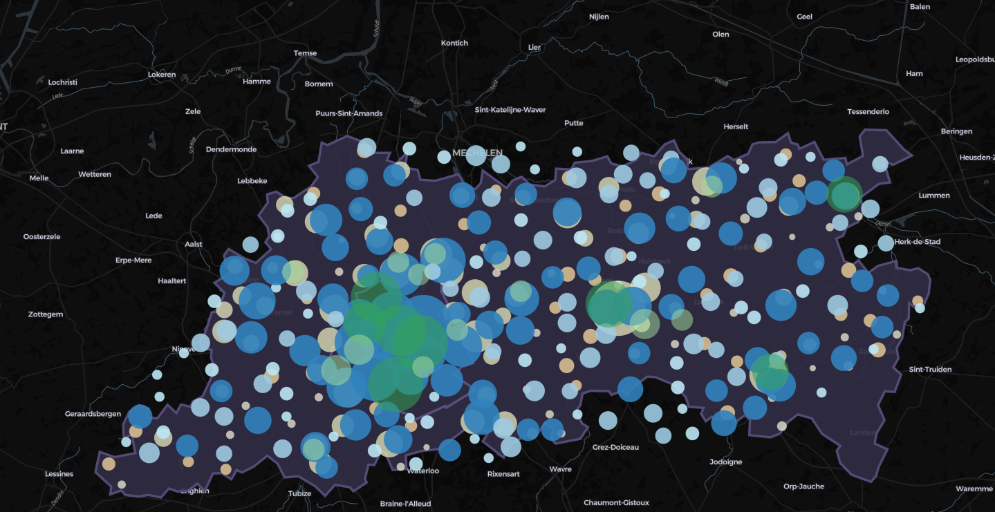
Solution A
Current Placement
Optimized Placement
Hospitals
CA Interventions
AEDs
Notes:
12min: waiting_time median for both ca and all

Slide 11
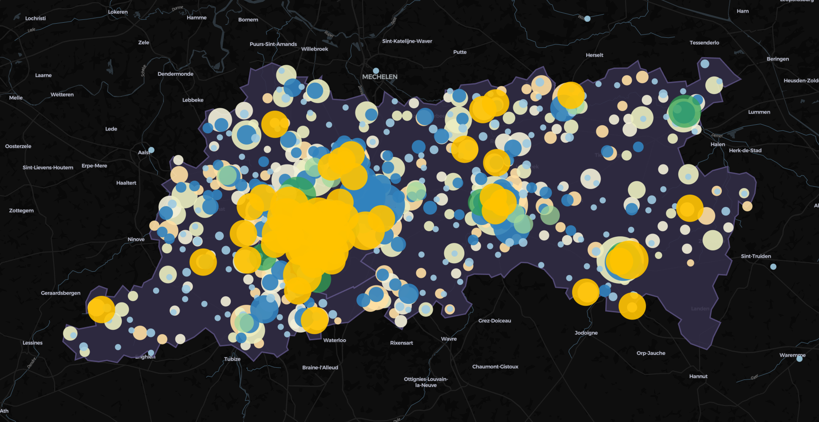
Solution B
Current Placement
Optimized Placement for 5% new AEDs
Hospitals
CA Interventions
AEDs
New AEDs
Notes:
12min: waiting_time median for both ca and all

Slide 12
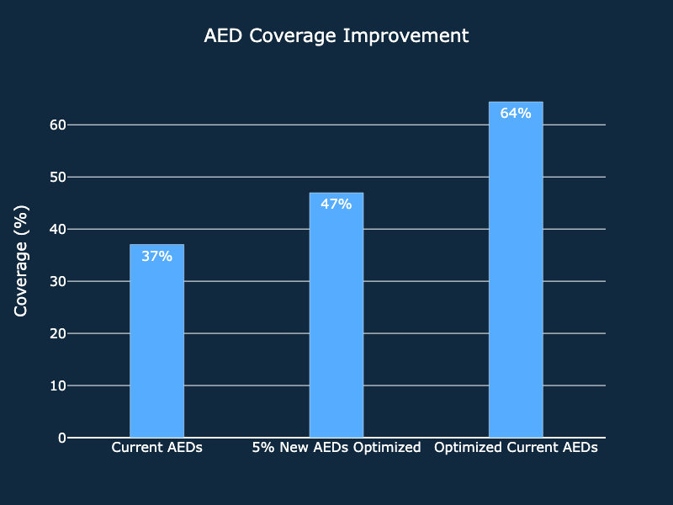
Coverage Gains by Location Optimization

Slide 13

Q&A
Thank you for your attention!

